Slide 1
Procedure to Purchase Academic Books of IDPS Kurnool
www.k12cart.com
Academic Year 2025-26
(For Online Purchase of Books).

Slide 2
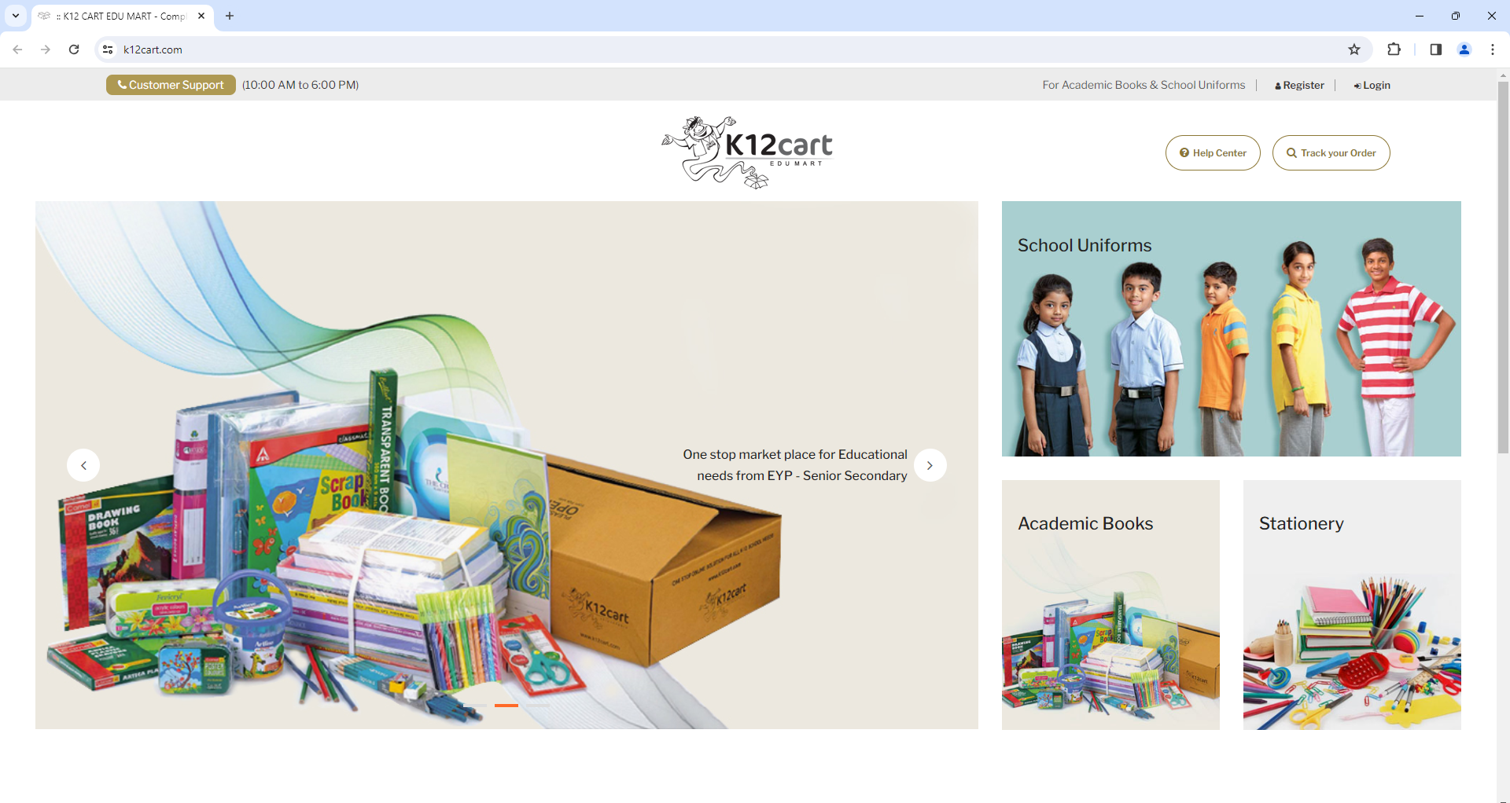
Click here to
‘Login or Register’
www.k12cart.com

Slide 3
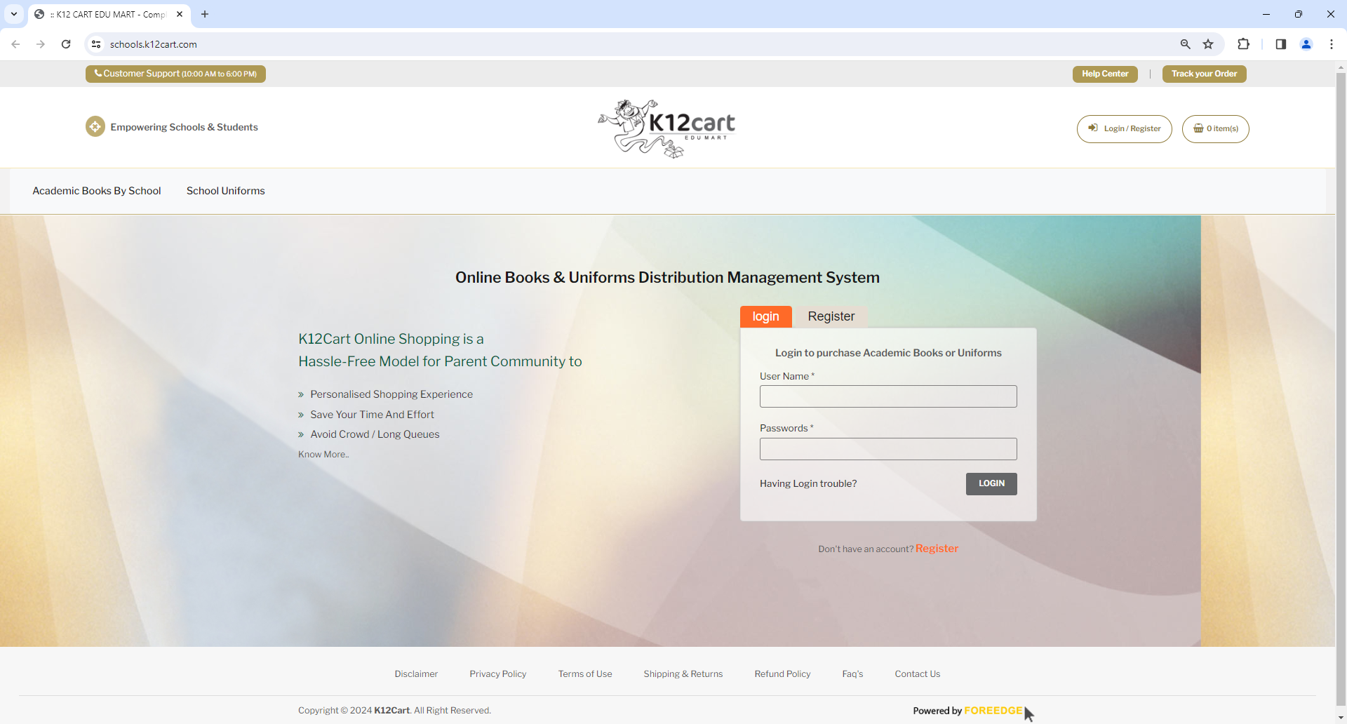
If you are New User
’Register’ here
If you are Existing User Login
Fill up all the fields to Register, you will receive User Name and Password on Mobile as SMS

Slide 4
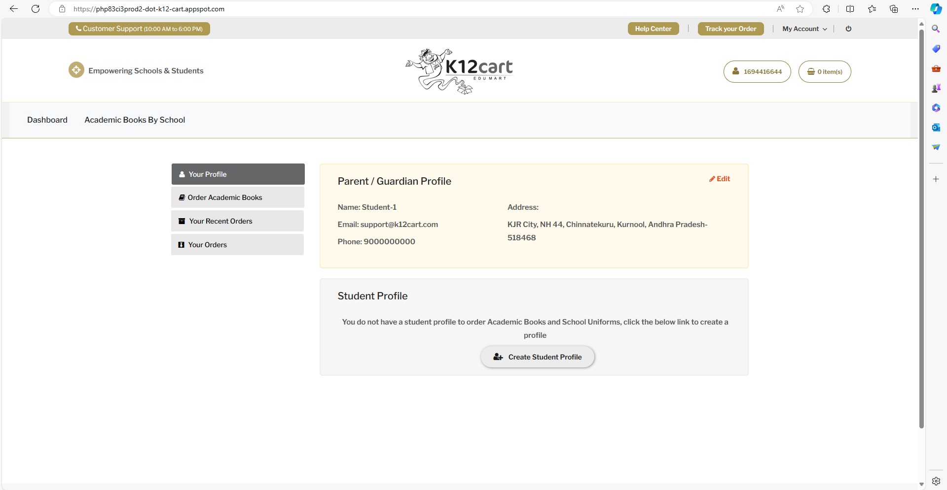
After Login you will see the dashboard like this
Create Student Profiles to Purchase the Books for a Particular Grade.
To Purchase Books click on the above button.

Slide 5
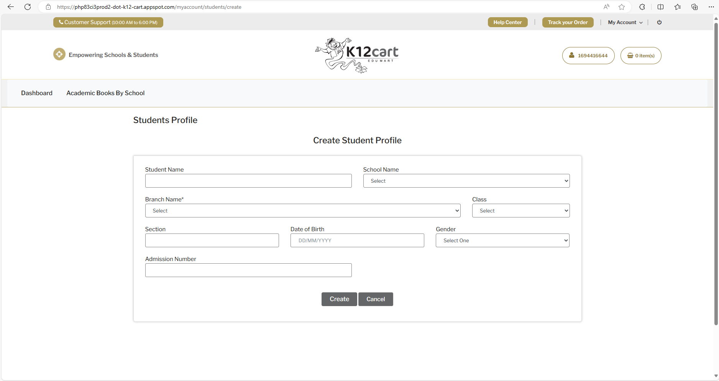
Fill all the Information above to create a student Profile (Parents can create one or more students for different Classes if required)

Slide 6
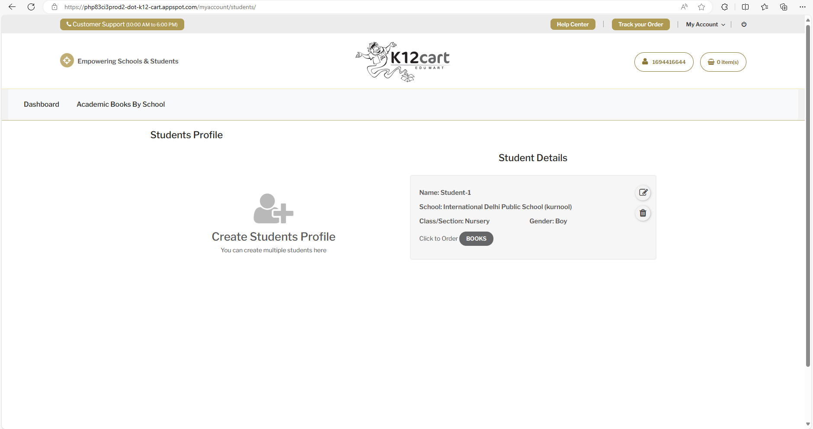
To create another student Profile if reqd.
To Update the existing Student Profile

Slide 7
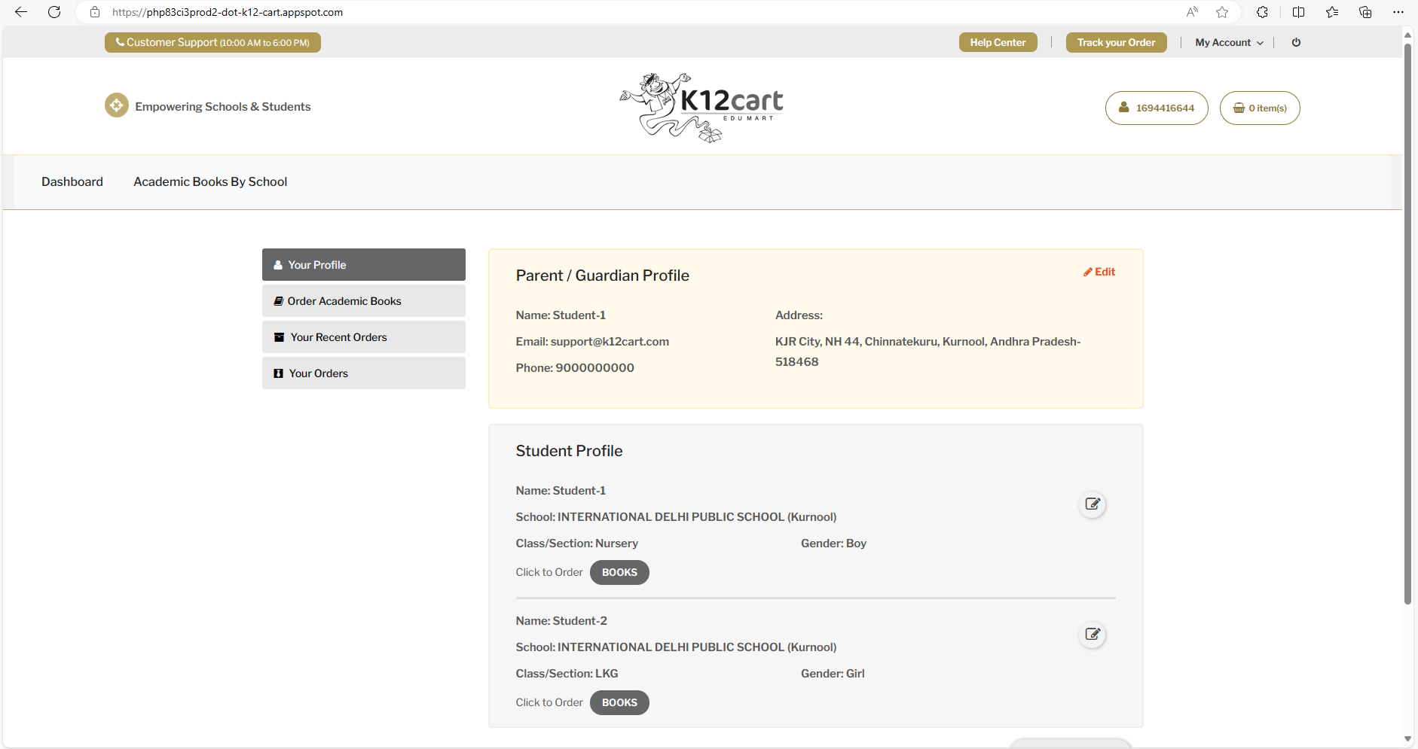
'Order Academic Books’
or Select ‘Books’ for a Student.

Slide 8
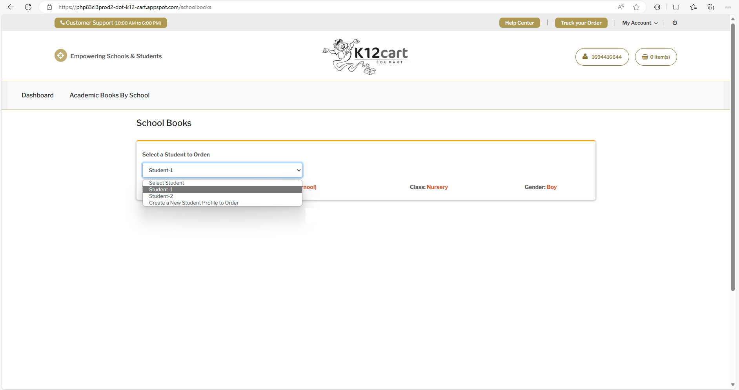
After selecting the Student, books list will be displayed for a Registered Class.

Slide 9
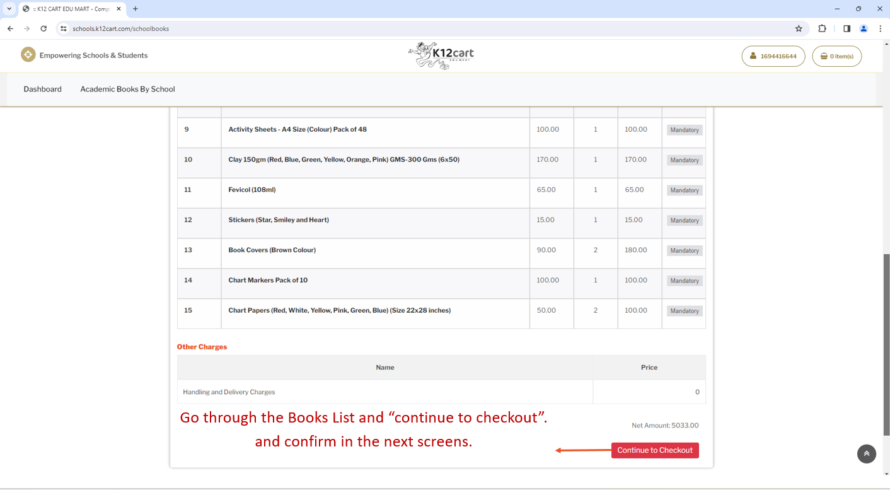

Slide 10
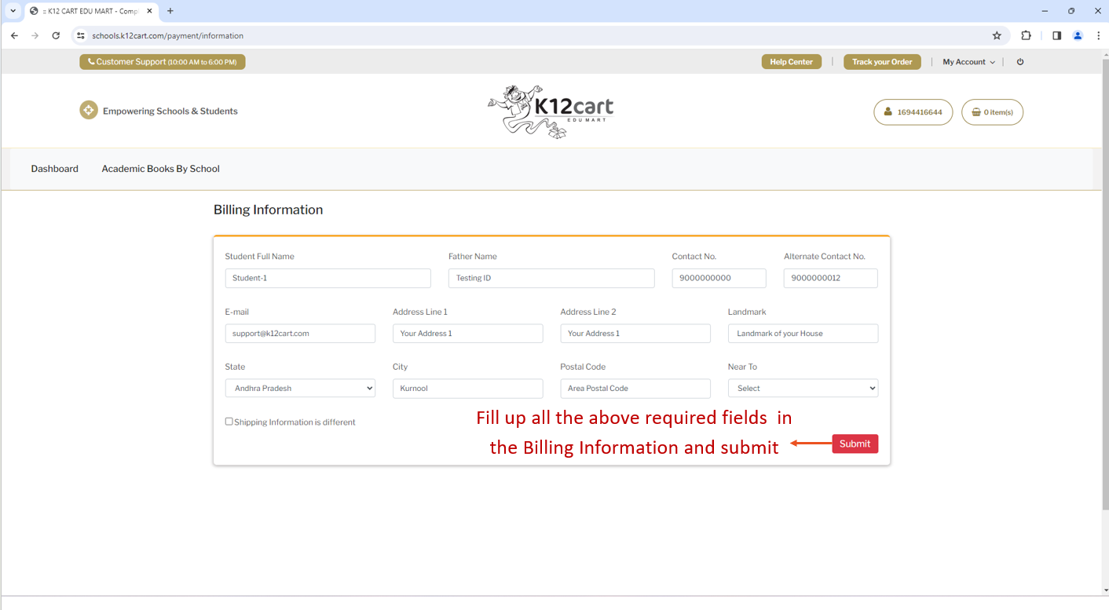

Slide 11
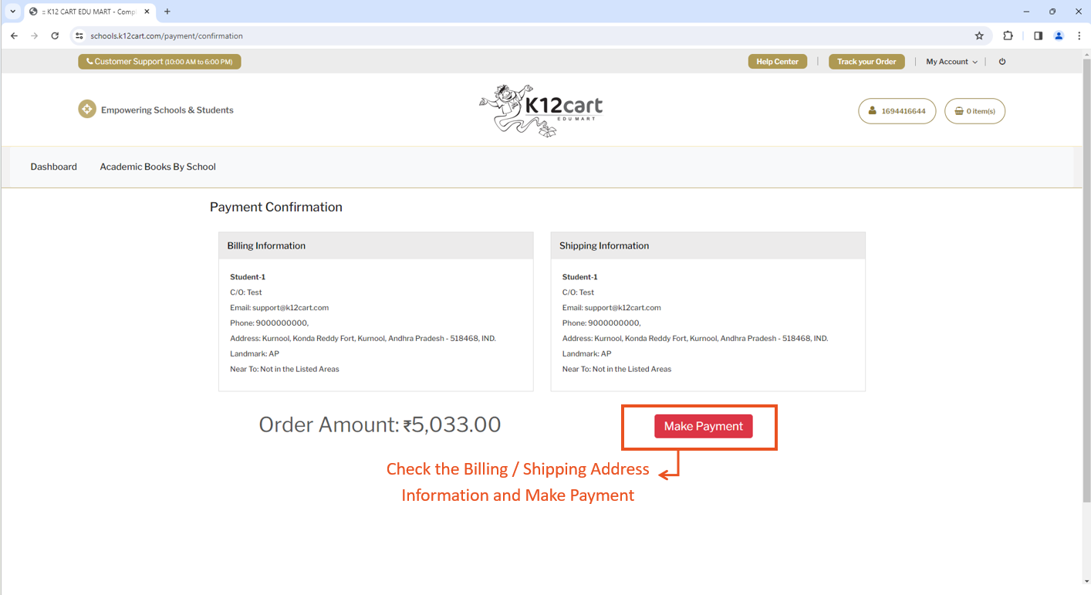

Slide 12
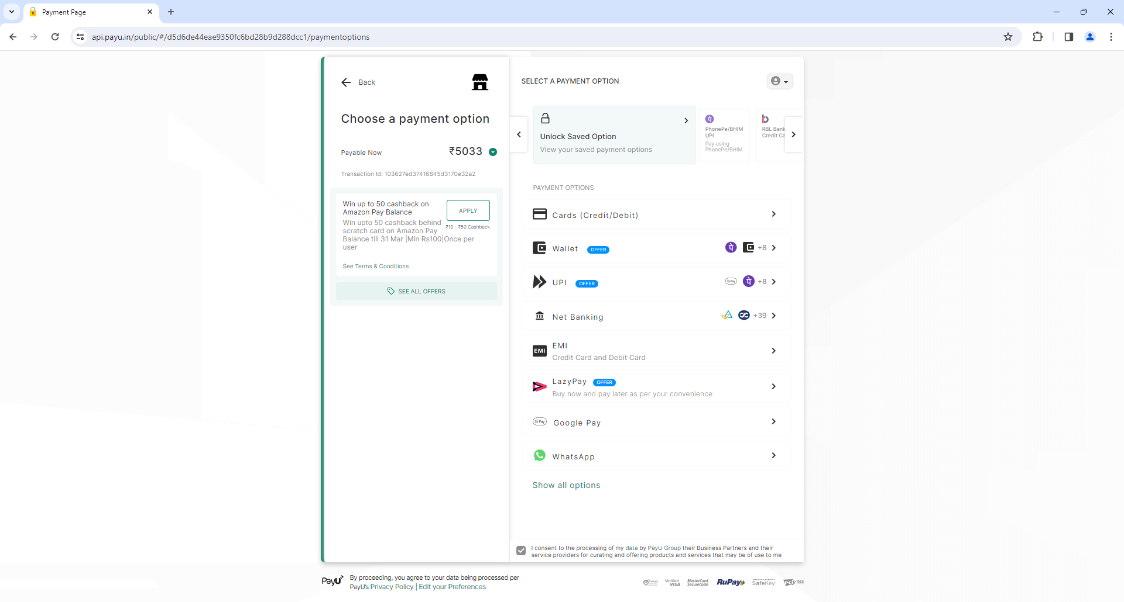
You will be redirected to this Payment Gateway Screen. Select the type of payment method to Pay.

Slide 13
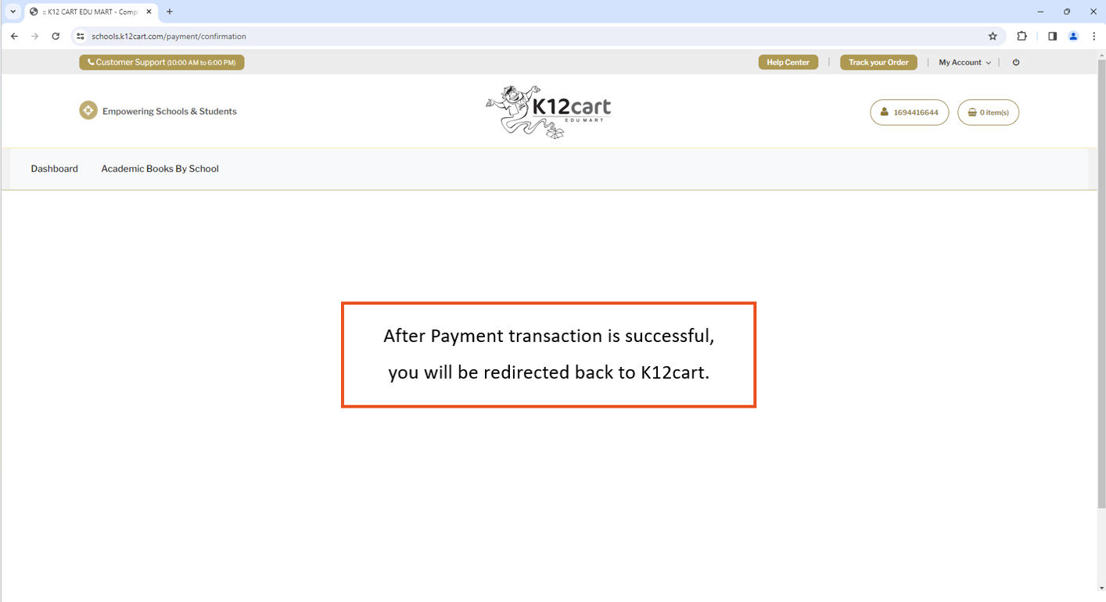

Slide 14
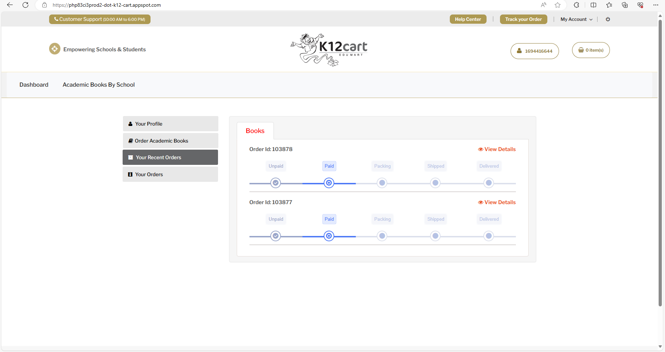
You can check your Order Status
Books will be sent to the IDPS School, Kurnool.

Slide 15
ThankYou
Technical Support : +91 9281085209 / 08.
E-mail: support@k12cart.com
( Timings : 10:00AM to 6:00PM )
Please call us for any support or clarifications.

